Slide 1
CLASS WORK

Slide 2
EXERCISE 1
What is data structure, Classify the data structures as primitive data structure and non-primitive data structures by providing 4 examples for each category.
Describe the storage representation of primitive data structure versus non-primitive data structure storage representation.
Describe the criteria to select a good algorithm.

Slide 3
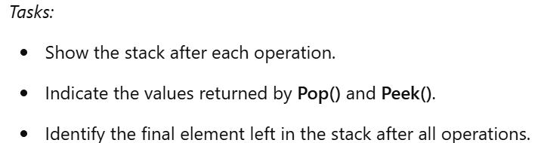
Exercises 2
You are given an empty stack. Perform the following sequence of stack operations and display the state of the stack after each operation. Indicate the element returned by Pop() and Peek() operations, and finally, identify the last remaining element in the stack.
Operations:
Push(15)
Push(25)
Push(35)
Pop()
Push(45)
Push(55)
Peek()
Pop()
Pop()
Push(65)
Peek()
Pop()

Slide 4
Exercises 3
For a given list:
None <- [1] <-> [2] <-> [3] <-> [4] <-> [5] <-> [7] <-> [8] <-> [9] <-> [10] -> None
Apply the steps of the algorithm for inserting an element at the head by demonstrating the insertion of the value 0 before 1 in the list.
Apply the steps of the algorithm for inserting an element in the middle by demonstrating the insertion of the value 6 after the value 5 in the list.
Apply the steps of the algorithm for inserting an element at the end by demonstrating the insertion of the value 13 after the value 10 in the list.

Slide 5
Exercises 4
Describe the steps you would take to sort the case of exam scores 23, 8, 45, 12, 67, 3, 34, 76, 19, 54, 29, 41, 88, 5, 72. using the merge sort algorithm.
Sort the same set of exam scores using the quick sort algorithm, taking the last number (72) as the pivot. Include the steps involved in the process.
Compare the time and space complexities of the merge sort and quick sort algorithms. Provide ways these complexities might influence your choice of sorting method in practical situations.

Slide 6
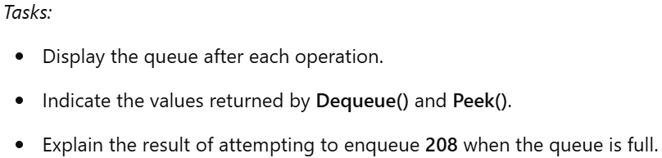
Exercises 5
You are working with an empty queue that has a maximum capacity of 5. Perform the following sequence of operations and display the state of the queue after each operation. Also, explain the behavior of the queue when attempting to enqueue an element beyond its maximum capacity.
Operations:
Enqueue(201)
Enqueue(202)
Enqueue(203)
Dequeue()
Enqueue(204)
Enqueue(205)
Peek()
Dequeue()
Enqueue(206)
Enqueue(207)
Dequeue()
Enqueue(208) (Discuss the queue's state and behavior when trying to enqueue 208 if the queue is full)

Slide 7
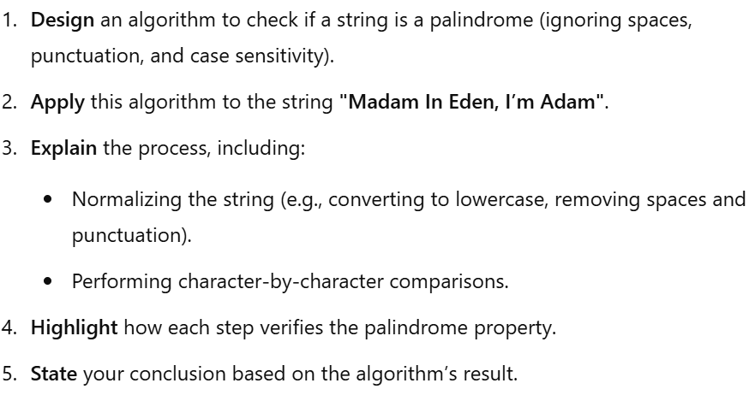
Exercises 6

Slide 8
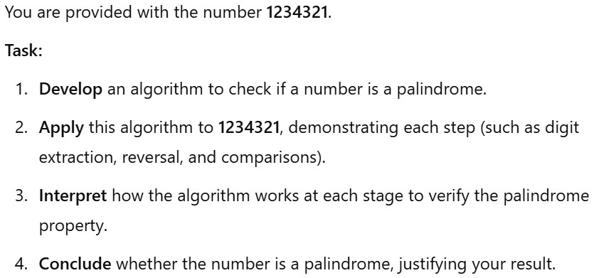
Exercises 7

Slide 9
Exercises 8
Apply the Euclidean Algorithm to determine the GCD of 8256 and 3168, showing all intermediate steps, including the division and remainder process.
Using the GCD obtained, calculate the LCM of 8256 and 3168. Clearly explain the formula used and how the result is derived.

Slide 10
Exercises 9
Generate the first 12 terms of the Fibonacci sequence using the Fibonacci algorithm.
Explain the step-by-step process of how the algorithm generates the sequence, including the use of loops or recursion, and how it handles base cases.

Slide 11
End

